Slide 1
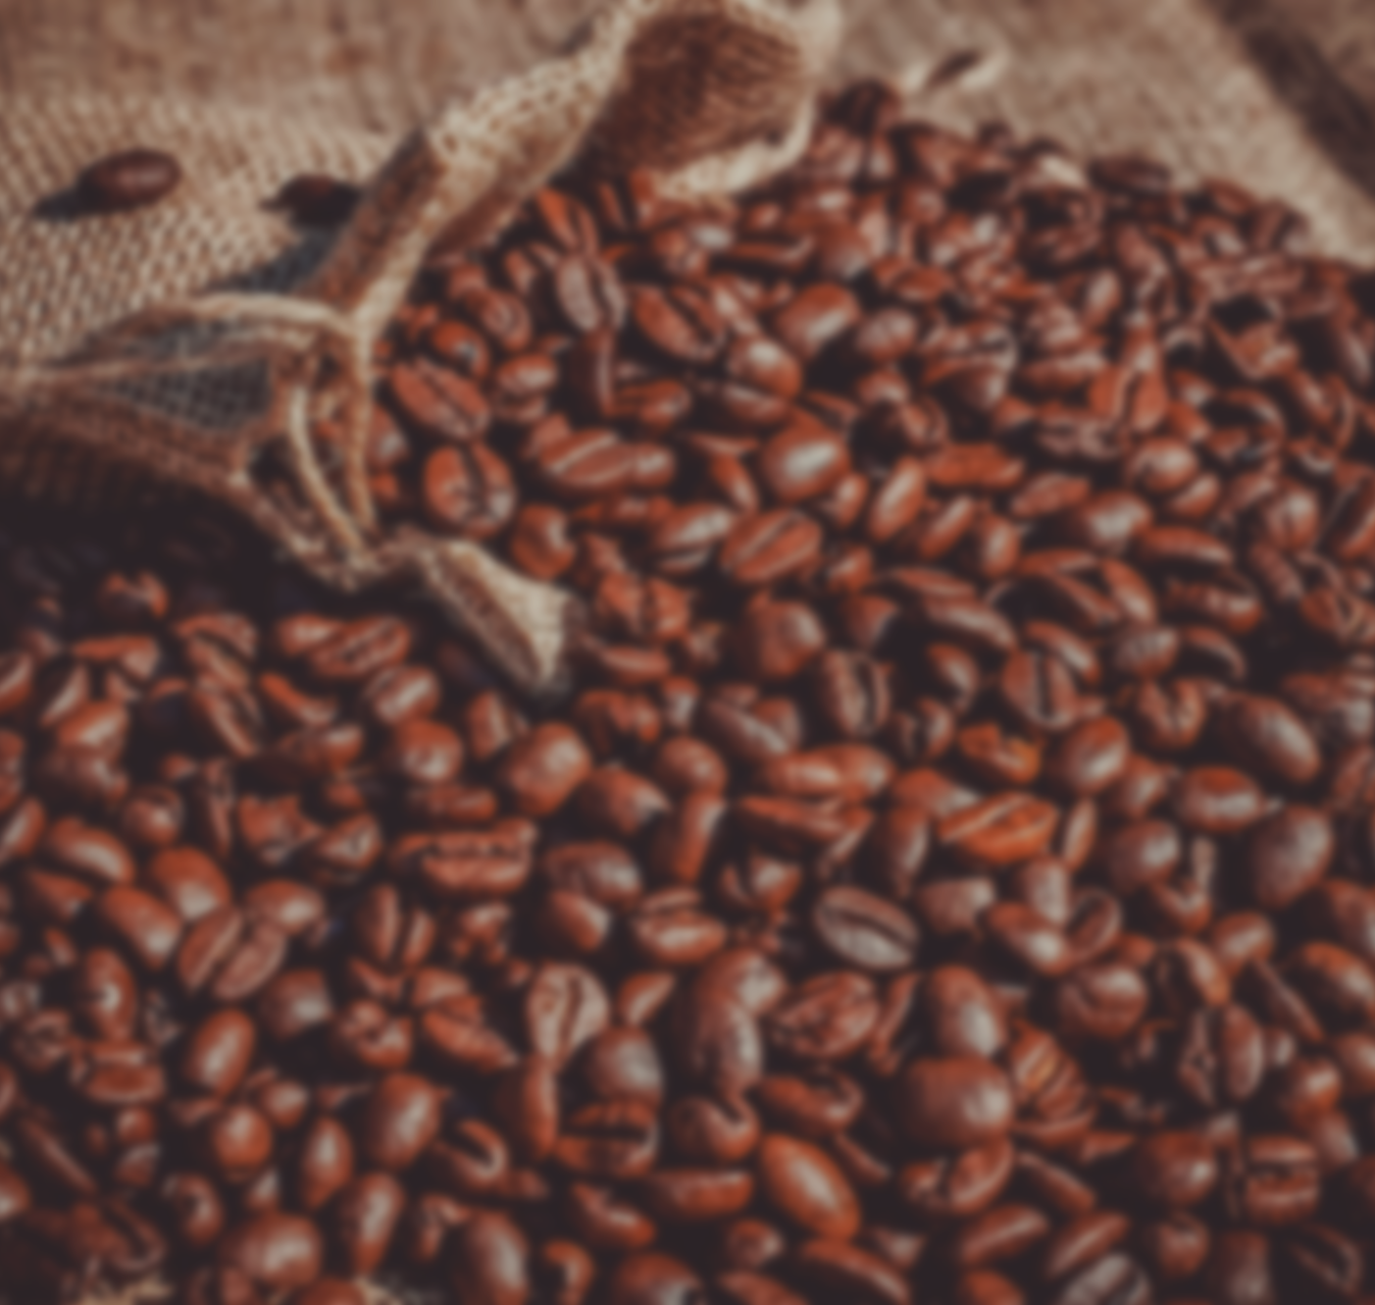
COFFEE SALES ANALYSIS

Slide 2
INDEX
Introduction
Objectives
Overview
Data cleaning
Business Questions
Method of Analysis
Conclusion

Slide 3
Introduction
Coffee is one of the most popular and widely consumed beverages globally. It has a rich
history, dating back centuries and is deeply ingrained in various cultures. The global
coffee market has been steadily growing. Urbanization and rising disposable income
contribute to increased coffee consumption. Health benefits associated with coffee,
such as reduced diabetes risk and increased energy, drive market growth. Consumers
seek premium products emphasizing quality. Consumers increasingly prefer ethically
produced coffee. Organic certification is gaining traction, especially in Asia and
Europe, due to the perception of reduced exposure to synthetic chemicals.

Slide 4
Objective
Understand Customer Preferences: It helps to explore the popularity of coffee verities
among customers across different cities and countries.
Evaluate Shop Performance: It helps to analyze the performance and aggregate ratings of shop to identify top-performing countries and cities.
Assess Service Offerings: It determines the availability and impact of services provided by the seller.
Track coffee type sales trend for better inventory management.
Analyze sales by country to aid expansion.
Analyze customer frequency in every year.
Monthly distribution of coffee for all countries.

Slide 5
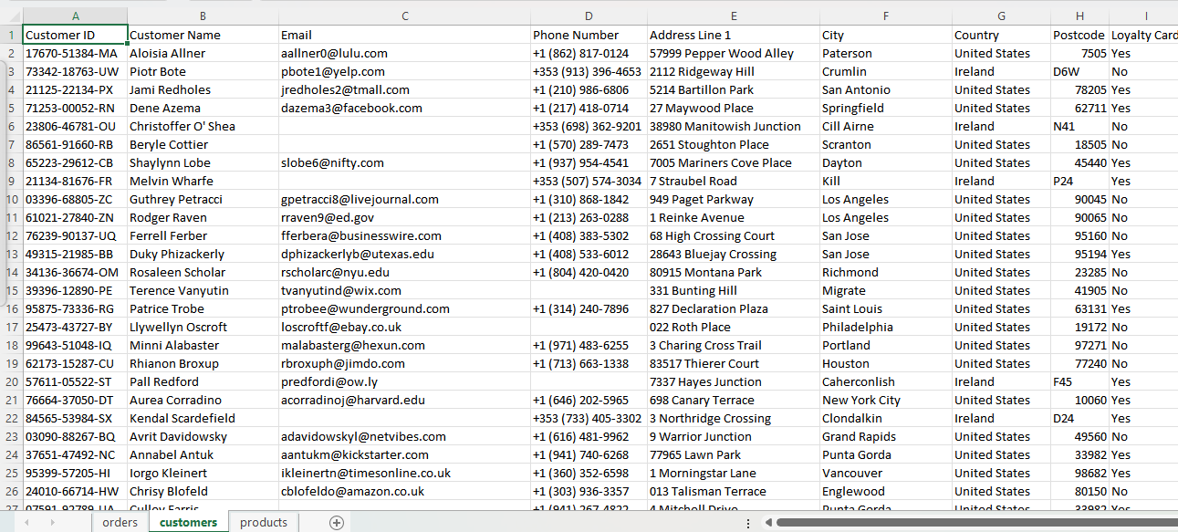
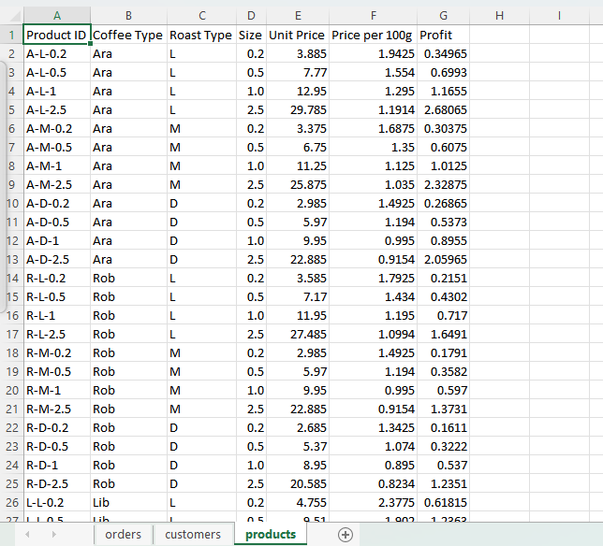
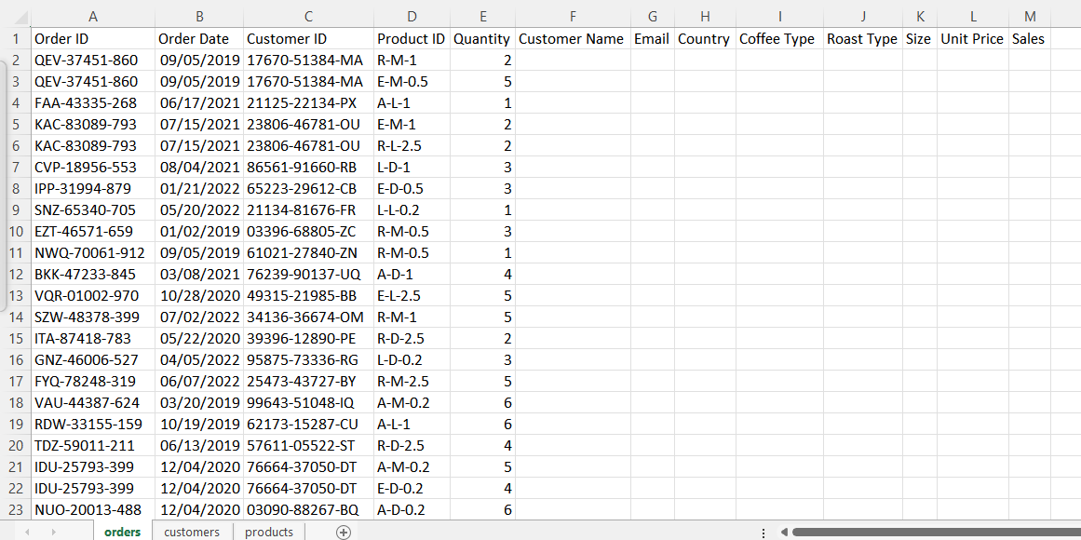
Overview Of all data
Data on coffee bean sales are divided into 3 separate sheets:
**Customers** Customer ID Card , Customer Name, Email, Phone Number , Address Line,City,Country,Postcode,Loyalty card.
**Product** Product Id , Coffee Type , Roast type ,Size, Unit Price, Price per 100g, Profit.
**Orders** Order Id, Order date,Customer ID, Product Id, Quantity.

Slide 6
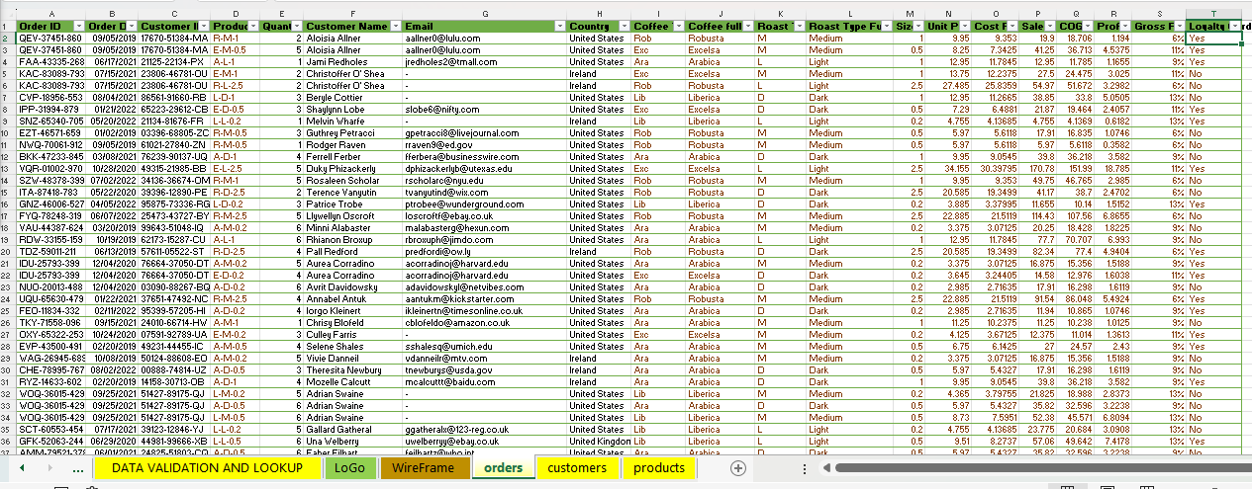
Data Pre Processing task
Using XLOOKUP function, merged the customer table in the orders table with the help of customer id: customer name, email (used IF function along with XLOOKUP as nested function ), country , loyalty card.
Using INDEX, MATCH, XLOOKUP function, merged the Products table in the orders table with the help of Product id: Coffee Type , Roast type ,Size, Unit Price.
All three tables were merged into a single table .

Slide 7
Data Cleaning
This stage began with creating a working sheet and transforming the datasets presented in different sheets into "Tables". After this we start getting to explore the data and check for any data quality issues.
Checking NULL values, blanks and Errors.
Removing duplicates, and irrelevant columns.
Made sure data is consistent and clean with respect to data type, data format and values used.
Created “Coffee Type Full Name” and “Roast Type Full Name” columns by using IF function.
Created “Sales” column by calculation and “Coffee Type Name” and “Roast Type Name” columns by using IF function.
Created “Cost Price” column by calculation with “Unit Price” and “Profit” columns.
Created “Sales” column by calculation with “Unit Price” and “Quantity” columns.
Created “COGS” column by calculation with “Cost Price” and “Profit” columns.
Created “Profit” column by calculation with “Sales” and “COGS” columns.
Created “Gross Profit” column by calculation with “Profit” and “Sales” columns.

Slide 8
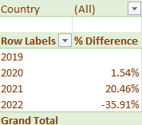
Business Questions
Year on Year change of the customer frequency for all the countries all together . In 2021 frequency increased touched its peak whereas it dropped in 2022.

Slide 9
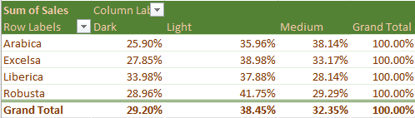
Business Questions
Total sales distribution of all the coffee types throughout the years in all countries. Robusta Light roast coffee type stands out of all .

Slide 10
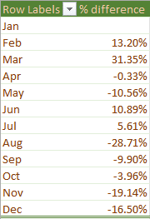
Business Questions
Monthly quantity distribution difference of all the coffee types in all countries. Where March has the highest distribution and august has the lowest .

Slide 11
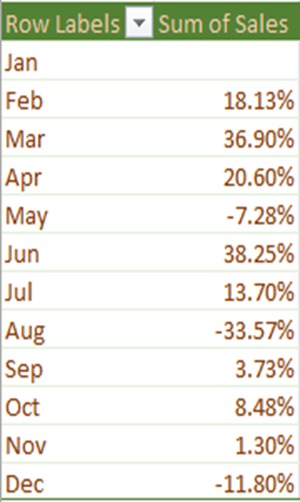
Business Questions
Monthly sales difference of all the coffee types in all countries. Where June has the highest sales and august has the lowest .

Slide 12
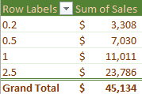
Business Questions
Coffee size wise sales of all the coffee types in all countries. Where sales of 2.5 Kg unit is more that the others units .

Slide 13
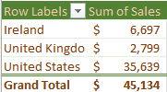
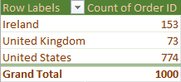
Business Questions
Total sales of all coffee type in each country , Where sales from United States is the highest.
Total Orders of all coffee type in each country. Where maximum orders came from United States.

Slide 14
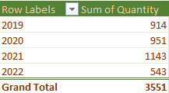
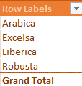
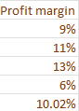
Business Questions
Total Quantity sold of all coffee type in all countries , Where sales in 2021is the highest.
Total Profit margin of all coffee type in all countries .

Slide 15
Business Insights
The 🇺🇸 The United States Takes the Crown in Coffee Sales .United States shines as the leading contributor to coffee sales revenue, surpassing all other nations.
Liberica Leads the Way in Revenue Generation . Liberica coffee takes the top spot in revenue generation, showcasing its impact on the coffee industry.
"Light" Roast Coffee Emerges as Revenue Leader . Among various roast types, "Light" roast coffee stands out as the leader in revenue generation.
Coffee Sales by Country:
Ireland - Liberica coffee outperforms other types in revenue in Ireland.
United States - Arabica coffee secures the top spot for revenue generation in the United States.
United Kingdom - Robusta coffee stands out as the revenue leader in the United Kingdom.
Sales Soar in 2021 with a 13.6% Surge While 2019 and 2020 saw nearly identical sales figures, 2021 witnessed a significant boost with a 13.6% increase compared to the previous year, reflecting a thriving coffee market.

Slide 16
Recommendation
Customer Segmentation and Targeting:
Identify high-value customers using the "Loyalty Card" status and purchase history.
Develop targeted marketing campaigns to increase retention and encourage repeat purchases.
Product Analysis:
Analyze the profitability of different coffee types and roast types.
Focus on promoting high-profit products and consider discontinuing low-profit items.
Sales Trends:
Identify peak sales periods and plan promotions or discounts during off-peak times.
Consider introducing seasonal products to boost sales.
Cost Management:
Review the cost prices and negotiate with suppliers to reduce costs.
Monitor the cost of goods sold (COGS) and aim to increase the profit margin.
Customer Feedback:
Collect and analyze customer feedback to improve product offerings and customer service.
Implement a feedback loop to continuously enhance the customer experience.

Slide 17
Conclusion
The United States produced the highest sales amount and all five (5) of the top customers are also from there. It’ll be essential to keep top customers satisfied and ensure needed products are always made available at our stores at the country.
In the bid to increase sales across the United Kingdom and Ireland that generated low sales, Better product advertisement and exposure will be needed to reach out to more customers. Keeping in mind that having more customers raise better chances of more sales.
In conclusion, our coffee sales order reflects a robust demand for our premium blends. There is a room for growth with rising consumer interest in quality and convenience. Let’s brew success together!

